Slide 1
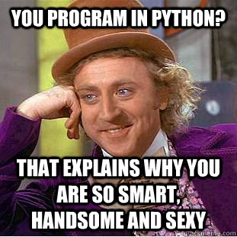
Learn Python

Slide 2
Lesson Topics
What is Python?
Who is this course for and final outcomes?
What can Python do for me?
Lets Get Started
Resources & Requirements
The basics
Data Types
Logic & Loops
Functions
Project

Slide 3
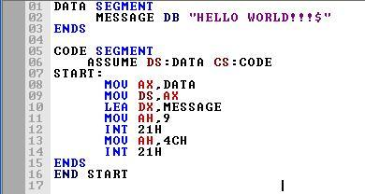
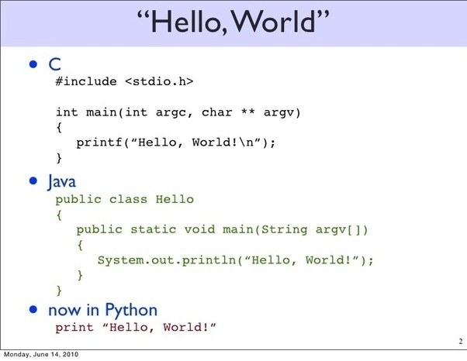
What is Python
Interpreted High Level Programming Language
Appeared around 1990
Created by Guido van Rossum
Object Oriented
Picture from https://www.google.com/url?sa=i&rct=j&q=&esrc=s&source=images&cd=&cad=rja&uact=8&ved=2ahUKEwjivZjKpJ7cAhVIf7wKHU_KBIEQjRx6BAgBEAU&url=https%3A%2F%2Fwww.quora.com%2FBetween-Java-and-Python-which-one-is-better-to-learn-first-and-why&psig=AOvVaw1KcbHBiul1tfja8S4wUWS2&ust=1531647193775909
http://cssimplified.com/wp-content/uploads/2013/10/Asm_program_Hello_World.jpg

Slide 4

Who is this course for?
Picture from https://eezeeenglishzone.wordpress.com/2017/02/23/confused-about-confusing-language/
Notes:
People with basic computer skills
People looking to add a new tool to their belt
People looking to automate tasks.
People looking for an introduction to programming

Slide 5
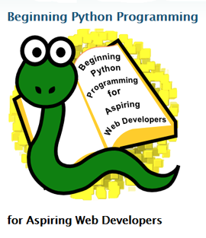
What can Python do for me?
Think & Work Logically
Calculation
Automation
Data Manipulation
Programming (Developing Applications)
Game Development
Website Design
IoT & Electronics (Raspberry Pi)
AI (Artificial Intelligence)
Much more
http://mediashift.org/wp-content/uploads/2014/06/python.png

Slide 6
Lets get Started - Resources
Requirements
Computer running Linux, Windows, Mac
Python 3.x preferred (Current version 3.7.0)
Resources:
https://www.python.org
https://docs.python.org/3/ - Documentation
https://www.codecademy.com/learn/learn-python
https://www.w3schools.com/python/
https://codecombat.com/ - game on python
https://checkio.org/ - game on python
https://atom.io/ (optional)
https://stackoverflow.com/

Slide 7
Let’s get Started! - The Basics
How do I access Python?
How do I write Python code?
Idle & other IDE’s e.g. Atom
Terminology and Syntax
Exercise
Create basic program to output “Hello World!”

Slide 8
Data Types - Variables
What is a Variable?
Variable Naming
A variable name must start with a letter or the underscore character
A variable name cannot start with a number
A variable name can only contain alpha-numeric characters and underscores (A-z, 0-9, and _ )
Variable names are case-sensitive (age, Age and AGE are three different variables)
Exercise
Create basic program to which outputs
“Hello <name>”
“Today, I am learning <language>
<name> must be a variable with your name assigned.
<language> must be a variable with the name of the language assigned to it.

Slide 9
Data Types - Numbers & Strings
Numbers
Int or Integer
Float
Complex
Strings

Slide 10
Data Types - Common Arithmetic Operators
 | Type | Example
+ | Addition | x = 3 + 3, x = 6
- | Subtraction | x = 5 - 1, x = 4
* | Multiplication | x = 2 * 5, x = 10
/ | Division | x = 15 / 3, x = 5
% | Modulus | x = 8 % 3, x = 2
Exercise
Create basic program to output the equation and answer of
5 times 5
33 divide by 3
12 modulus 5 (can you guess what this will be?)

Slide 11
Data Types - Common Assignment Operators
 | Type | Example
= | Equals | x = 3
+= | Equals Plus | x += 3 (x = x + 3)
-= | Equals Subtraction | x -= 3 (x = x - 3)
*= | Equals Multiplication | x *= 3 (x = x * 3)
/= | Equals Division | x /= 3 (x = x / 3)

Slide 12
Data Types - Common Comparison and Logical Operators
 | Type | Example
== | Is Equal to | x == 3
!= | Not Equal to | x != 3
< | Less than | x < 3
> | Greater than | x > 3
 | Description | Example of True
and | True if both are true | x > 3 and x < 10
or | True if one is true | x < 3 or x >10
not | Inverse of and | not(x > 3 and x < 10)

Slide 13

Data Types - Lists, Tuples, Sets & Dictionaries
List is a collection which is ordered and changeable. Allows duplicate members. uses [ ]
Tuple is a collection which is ordered and unchangeable. Allows duplicate members. Uses ( )
Set is a collection which is unordered and unindexed. No duplicate members. Uses { }
Dictionary is a collection which is unordered, changeable and indexed. No duplicate members. Uses { }
Exercise:
Create a List of 5 fruit and display only the 3rd one
Create a dictionary of months and birthdays. 1 month to 1 birthday and display any birthday.

Slide 14
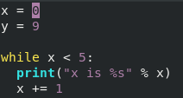

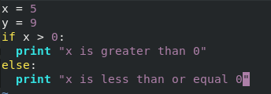


Logic & Loops
If… Else
While
For
Exercise:
Using the previous list. Create a for loop that iterates and prints each item.
Bonus. Use an if to filter out 1 of the list members.

Slide 15
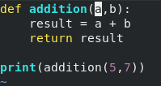
Functions
A block of code
Runs only when called
Can return a result
Function Name
Parameters
Exercise:
Create a function that does multiplication of two numbers and returns the result.
Then print the returned value.

Slide 16
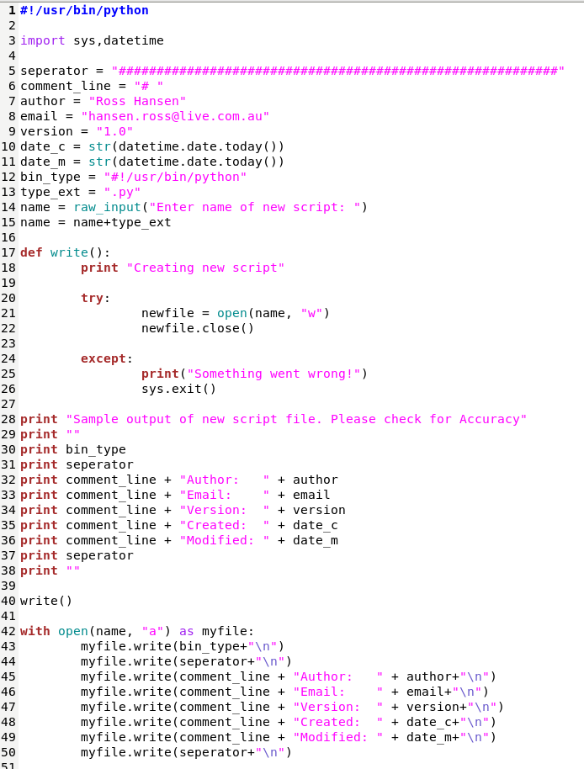
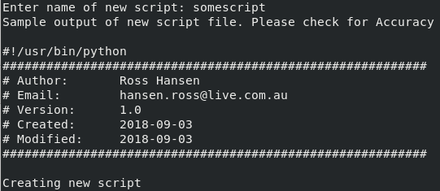
Example script

Slide 17
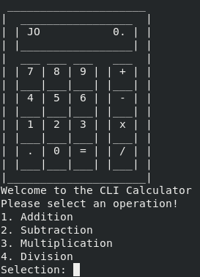
Project Time
Aim: build a simple CLI calculator which can do the basic add, minus, multiply and divide.
The calculator should have a menu that asks the users what they want to do.
It will then ask for the two numbers and perform the calculation selected.
https://www.asciiart.eu/electronics/calculators

Slide 18
Python OOP
Object Oriented Programming
What is it?
Why Use it?
Instantiation
Inheritance

Slide 19
Classes
Attributes
Methods
Constructors

Slide 20
GUI (Graphical Users Interfaces)
TKinter
Django
Flask
Many others

Slide 21
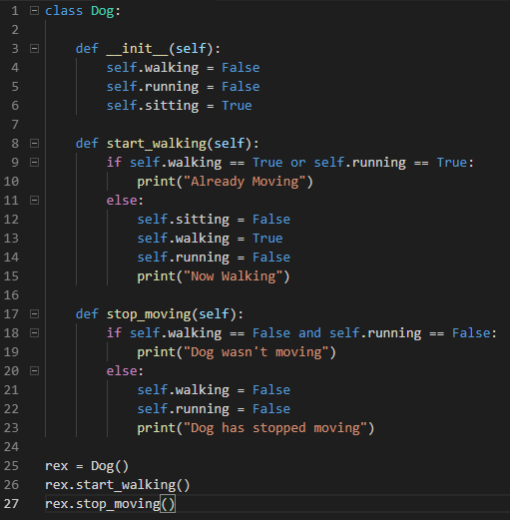
Example Class

Slide 22
Project: Todo List
Objective: To create a simple todo list program.
Requirements:
Must have at least 2 classes
Must have a Menu
Menu must allow you to add task
Menu must allow you to delete task
Menu must allow you to view tasks.

